Slide 1

Data Programming
Final Project
Submission by:
Yokesh Kalaialagan- 200543265
Harish Nagarajan – 200514391
Aishwarya Sivacoumar - 200543267

Slide 2
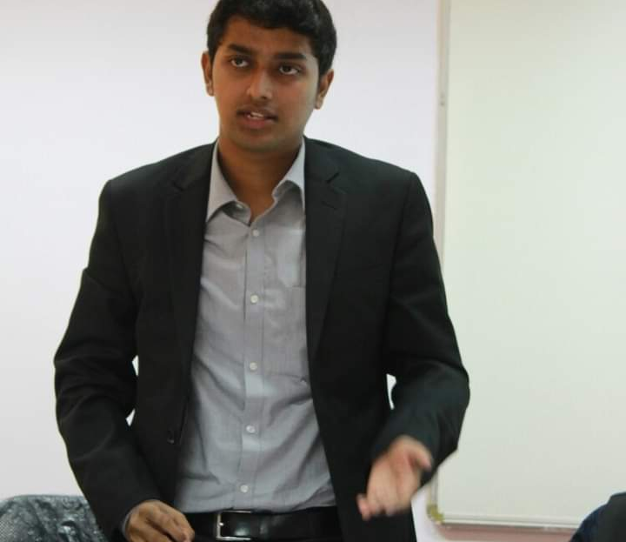

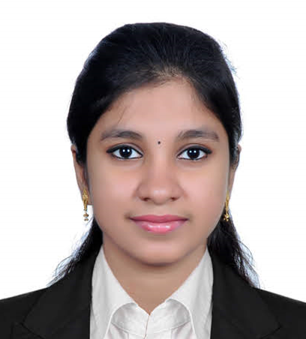
OUR TEAM
Harish Nagarajan
Yokesh Kalaialagan
Aishwarya Sivacoumar
PROJECT HEAD
DATA ANALYST
DEVELOPER

Slide 3
Introduction to the Project
The world's population is growing rapidly, which is leading to increasing levels of chaos. To prevent this chaos from causing harm, our team has identified data analysis as a valuable asset for analyzing the current situation and planning for a better future.
Our project focuses on analyzing a dataset that covers the years 1952 to 2007 and includes information about population, year of survey, and GDP for countries around the world. By using this dataset, we aim to predict the current situation for each country.
To conduct our analysis, we have created six different charts to help us interpret the data. These charts are an essential part of our project and provide us with valuable insights into the trends and patterns in the dataset.

Slide 4
Our Dataset
The dataset we are using consists of six different variables: the name of the country, the year in which the survey was conducted, the country's population, the continent where the country is situated, the life expectancy of the country's inhabitants, and the GDP rate for that particular year.

Slide 5
The Project
The project is carried out on a Jupyter computing platform and involves the utilization of the Pandas Library, which provides access to a range of data analysis tools.
The Pandas Library is a software package designed for the Python programming language that is used for data analysis and manipulation. It provides a range of tools and functions for managing numerical tables and time series data in particular.

Slide 6
2. The project utilizes a sqlite Database to store both the dataset and the analytical graphs that are generated.
3. In this project, Plotly is employed to create graphs that are both meaningful and useful in supporting the project's ideas and concepts.

Slide 7
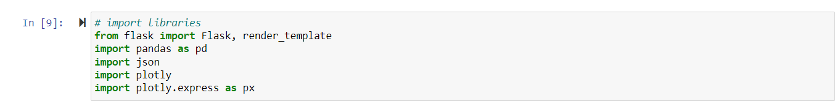
4. Use of Flask
Flask is a Python web framework that is small in size and lightweight, making it easier for developers to create web applications using Python. It offers various useful tools and features, providing flexibility and accessibility to new developers who can build web applications quickly using just a single Python file.

Slide 8
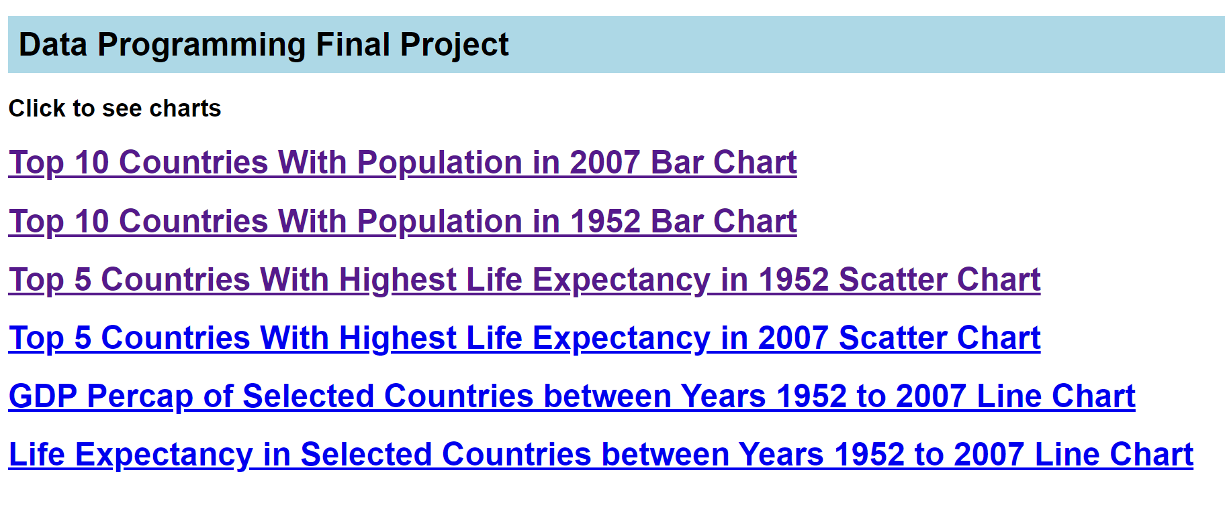
Output of Flask

Slide 9
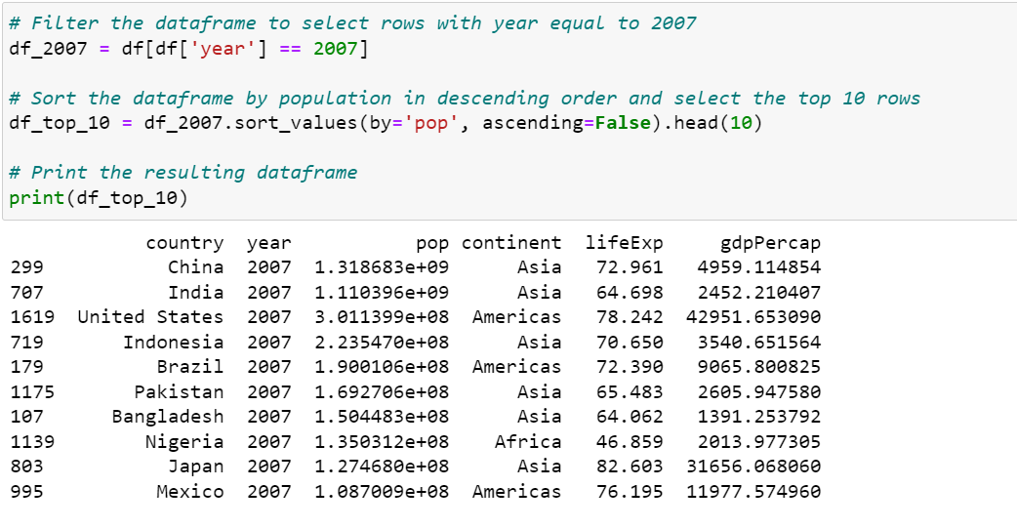
The project makes use of analytical tools to deploy 6 Charts.

Slide 10
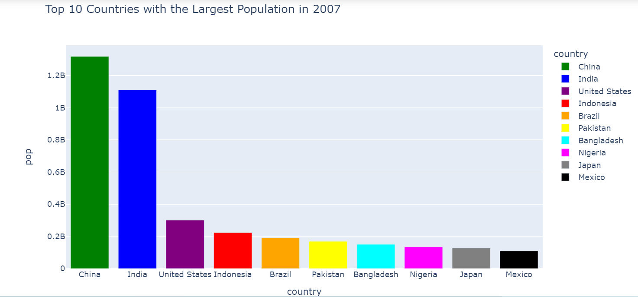
Output Charts

Slide 11
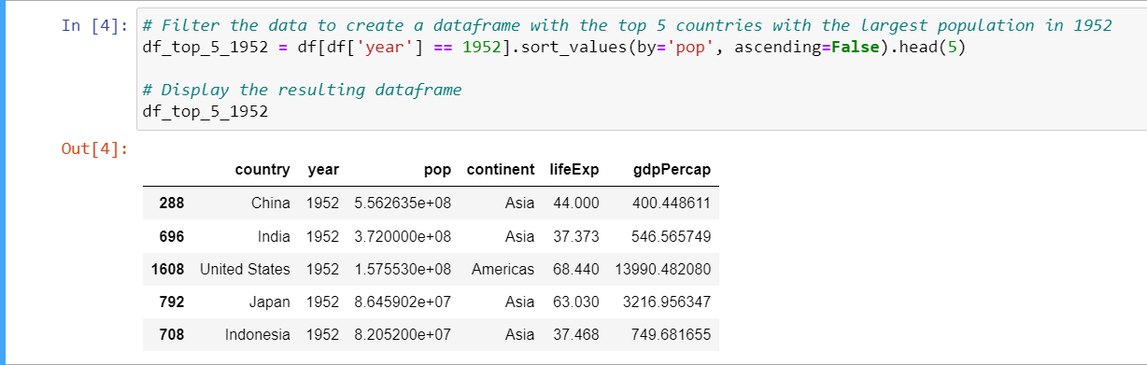
The project makes use of analytical tools to deploy 6 Charts.

Slide 12
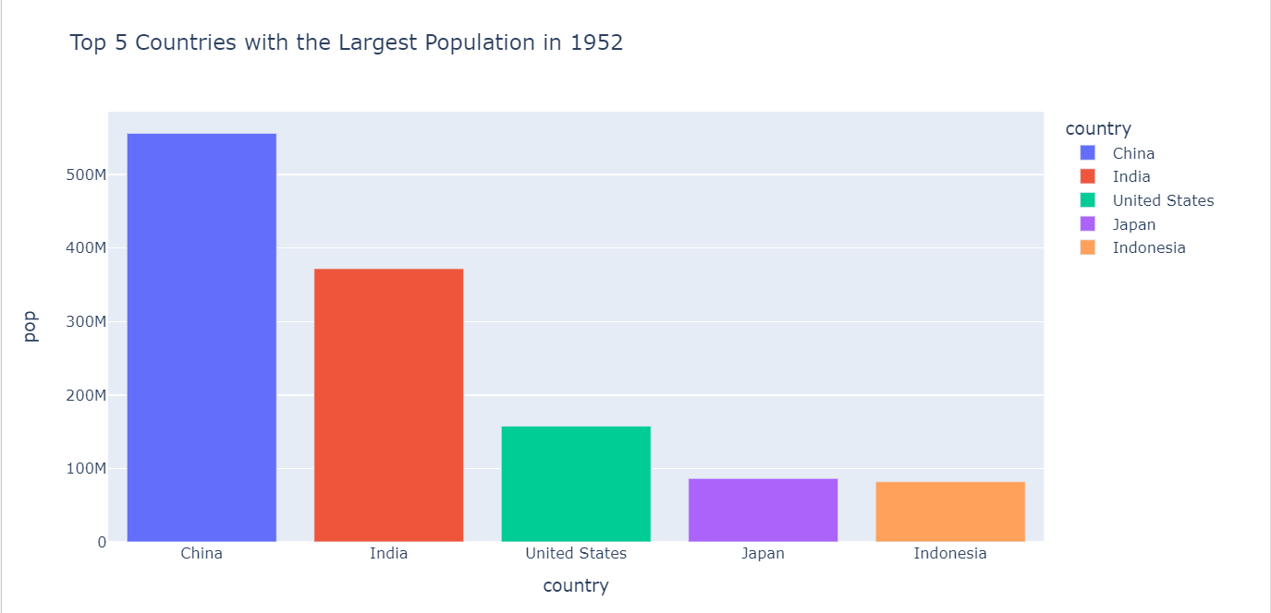
Output Charts

Slide 13
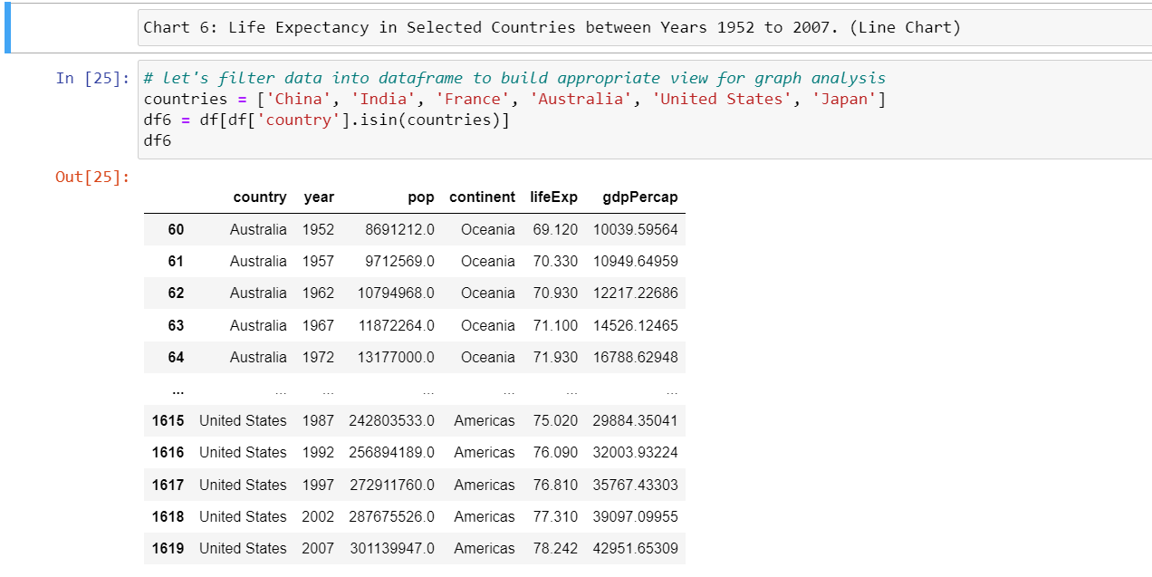
The project makes use of analytical tools to deploy 6 Charts.

Slide 14
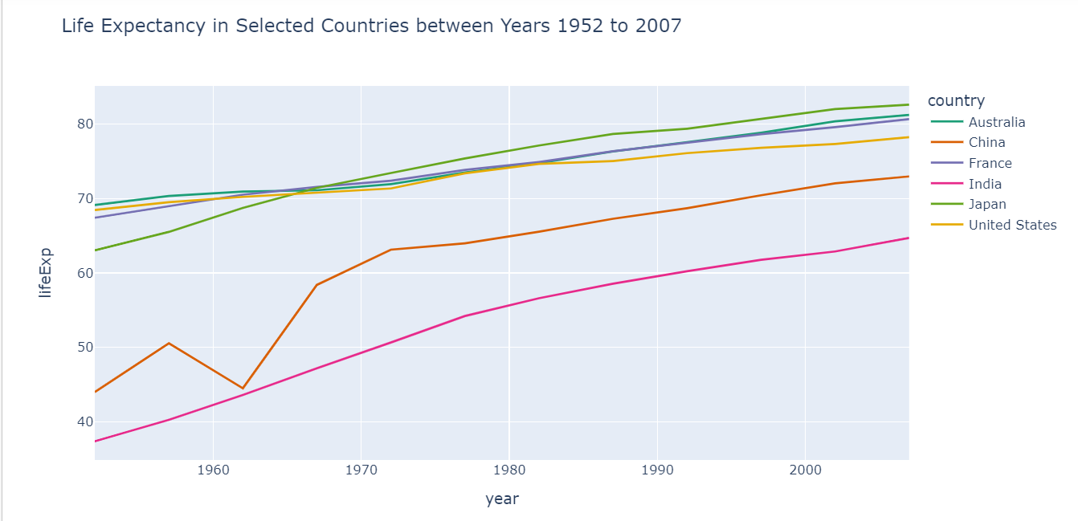
Output Charts

Slide 15
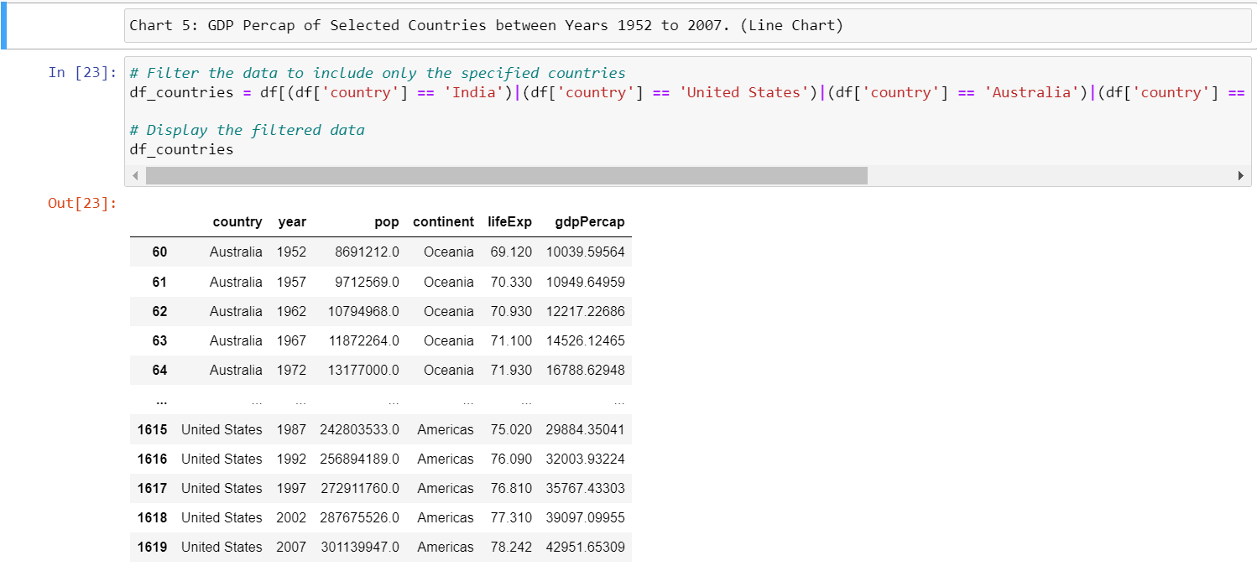
The project makes use of analytical tools to deploy 6 Charts.

Slide 16
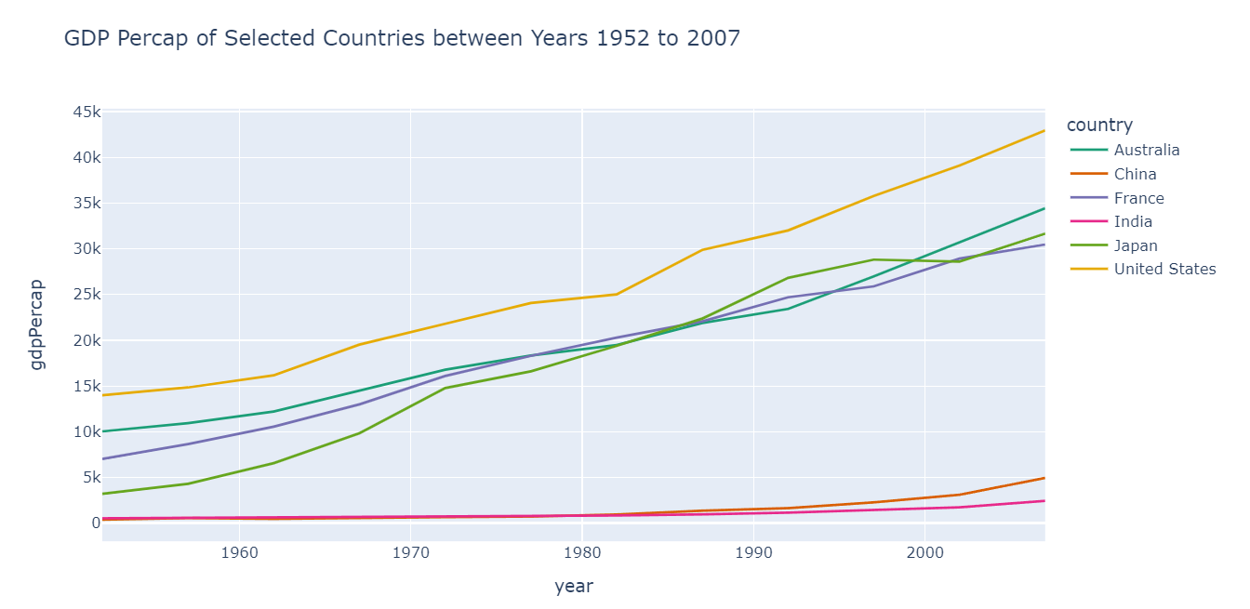
Output Charts

Slide 17
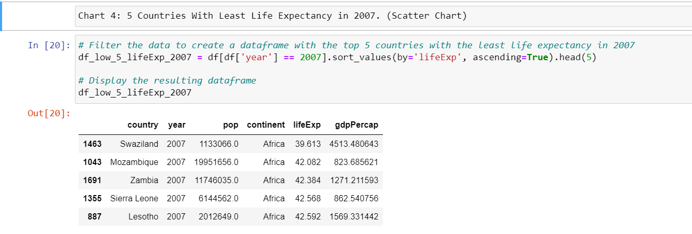
The project makes use of analytical tools to deploy 6 Charts.

Slide 18
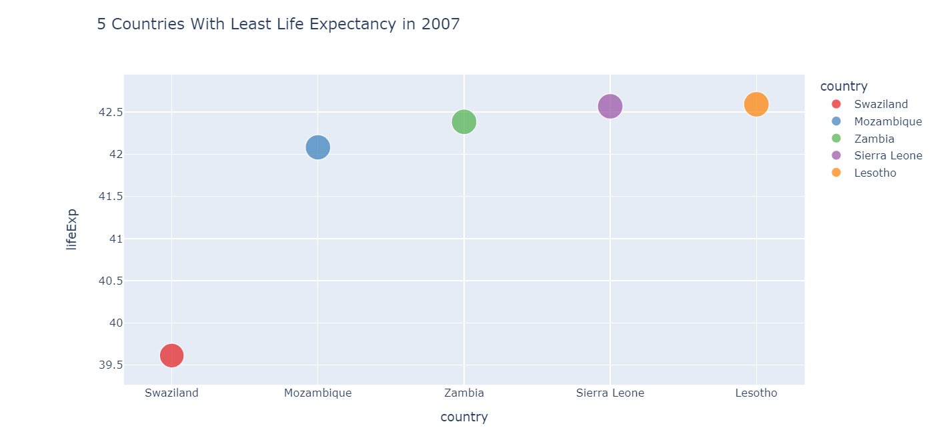
Output Charts

Slide 19
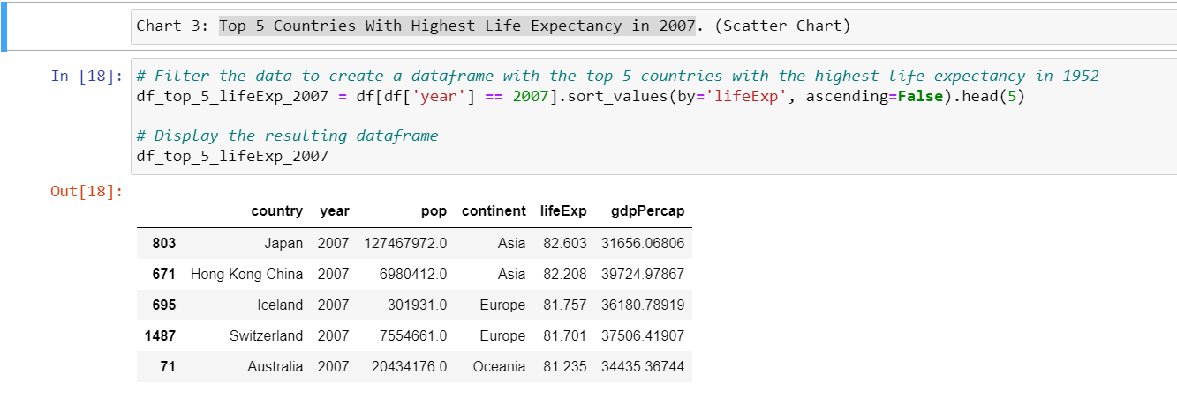
The project makes use of analytical tools to deploy 6 Charts.

Slide 20
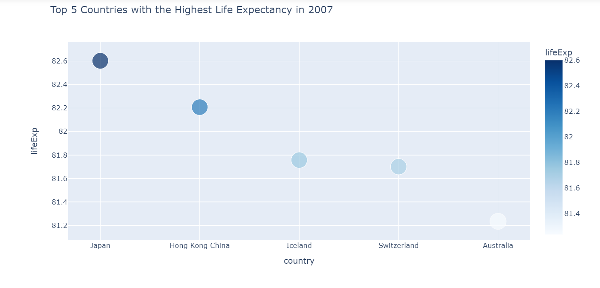
Output Charts

Slide 21
Thank You!!!!

